Slide 1
Understanding Left Recursion in Context-Free Grammars
Why It Matters in Parser Design and How to Eliminate It
Presented by: Zefasil Mulu
Student ID: 1508437
Course: Principles of Compiler Design

Slide 2

Introduction to Left Recursion
1
2
Definition
Direct Left Recursion
A grammar is left-recursive if a non-terminal A can derive a string starting with A in one or more steps.
Example: A → Aα | β
A immediately derives itself.
3
Indirect Left Recursion
Example: A → Bα, B → Aβ
A derives itself through another non-terminal.
Simple Example: Direct Left Recursion
E → E + T | T
Here, E can immediately derive a string starting with E.

Slide 3

Why Is Left Recursion Problematic?
Top-Down Parsers Fail
Recursive descent and predictive (LL) parsers enter infinite recursion or loops.
The Infinite Loop
Parse E:
Try E → E + T
Parse E: // Infinite recursion!
Bottom-up parsers (like LR) can handle left recursion, but it's often eliminated for consistency.

Slide 4
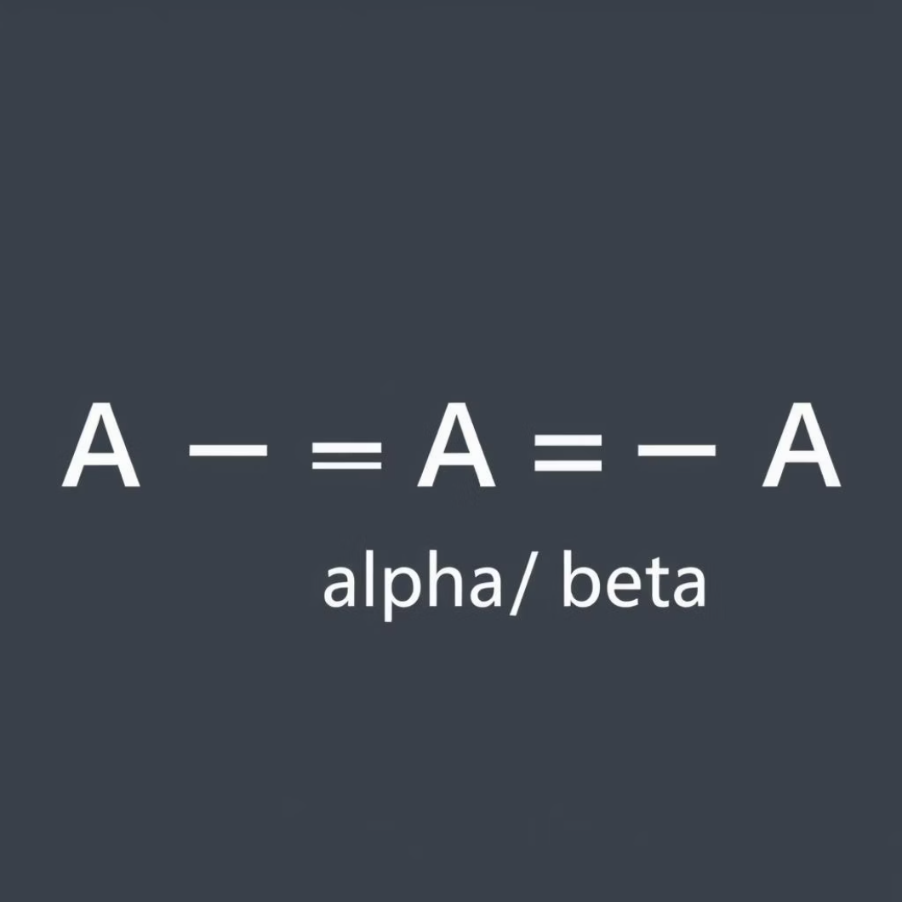
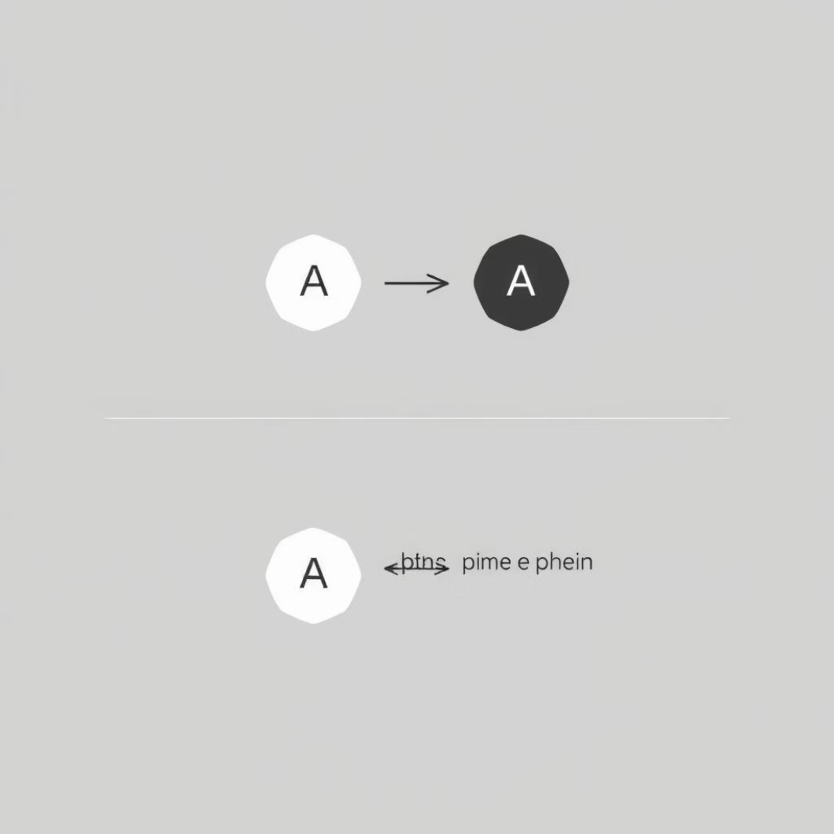
Direct Left Recursion Elimination
Original Grammar
Eliminated Grammar
A → Aα | β
A → βA'
A' → αA' | ε
Example Transformation
Original: E → E + T | T
Eliminated: E → T E'
E' → + T E' | ε

Slide 5
Step-by-Step Elimination Algorithm
01
02
Identify Rules
Replace A
For each rule A → Aα₁ | ... | Aαₙ | β₁ | ... | βₘ, where no βᵢ starts with A.
Replace with A → β₁A' | β₂A' | ... | βₘA'.
03
Define A'
Define a new non-terminal A' → α₁A' | α₂A' | ... | αₙA' | ε.
Visual Representation
Before: A → Aα | β
After: A → βA'
A' → αA' | ε

Slide 6
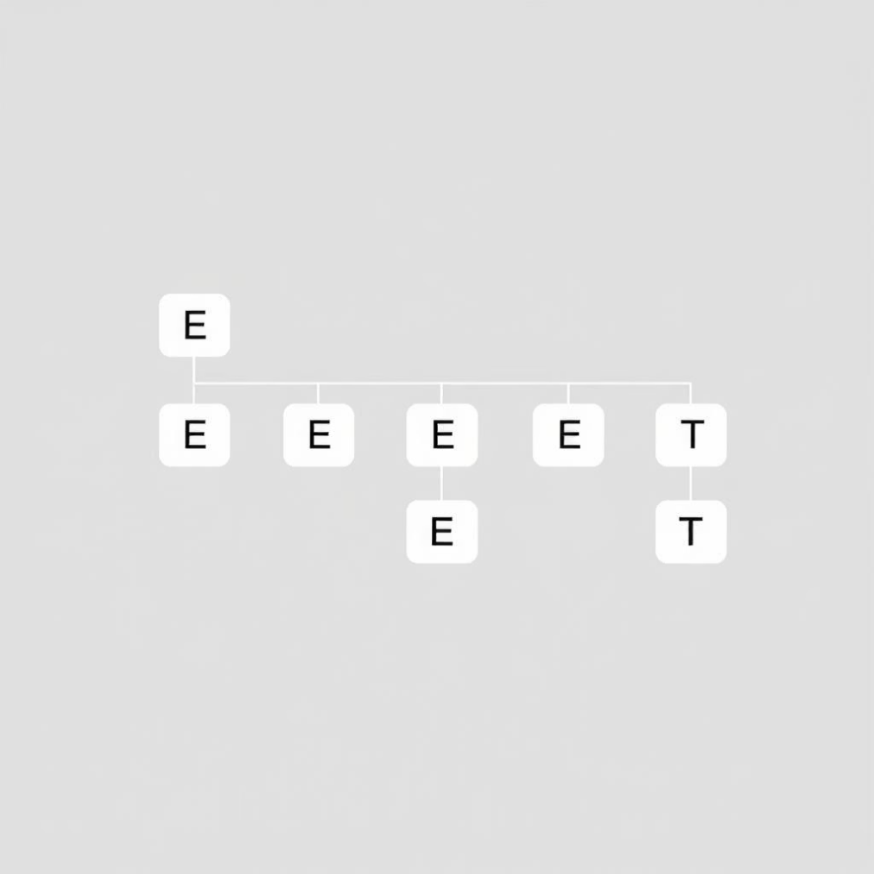
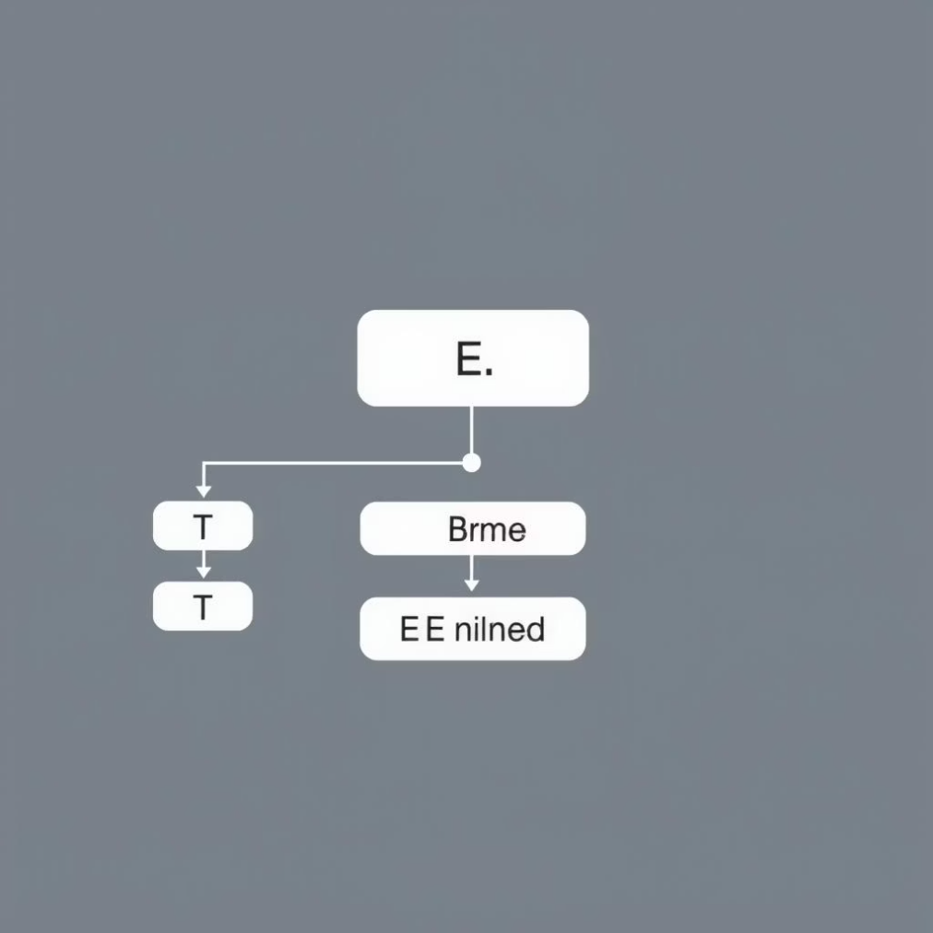
Worked Example: Arithmetic Expressions
Original Left-Recursive Grammar
After Elimination
E → E + T | E - T | T
T → T * F | T / F | F
F → ( E ) | id
E → T E'
E' → + T E' | - T E' | ε
T → F T'
T' → * F T' | / F T' | ε
F → ( E ) | id
Parse Tree Comparison
Original: Left-associative tree (natural for humans)
Eliminated: Right-associative tree (still correct, just structured differently)

Slide 7



Indirect Left Recursion Elimination
Problem: Chains of productions causing left recursion indirectly.
S → A a | b
A → S c | d
Here: S → A a → S c a (indirect left recursion)
Order Non-Terminals
Assign an order: A₁, A₂, ..., Aₙ.
Substitute Rules
For i = 1 to n, and j = 1 to i-1, replace Aᵢ → Aⱼγ with Aᵢ → δ₁γ | δ₂γ | ... where Aⱼ → δ₁ | δ₂ | ...
Eliminate Direct Recursion
Eliminate direct left recursion in Aᵢ.

Slide 8


Real-World Impact on Parser Performance
Without Elimination
With Elimination
Recursive descent: Stack overflow
LL(1) parsers become possible
Predictive parsers: Infinite loops
Recursive descent works correctly
Parser generators: Errors or failure
Parse trees remain semantically equivalent
Case Study
Early Pascal compilers used hand-written recursive descent, requiring grammar transformations. Modern tools often automate this.

Slide 9
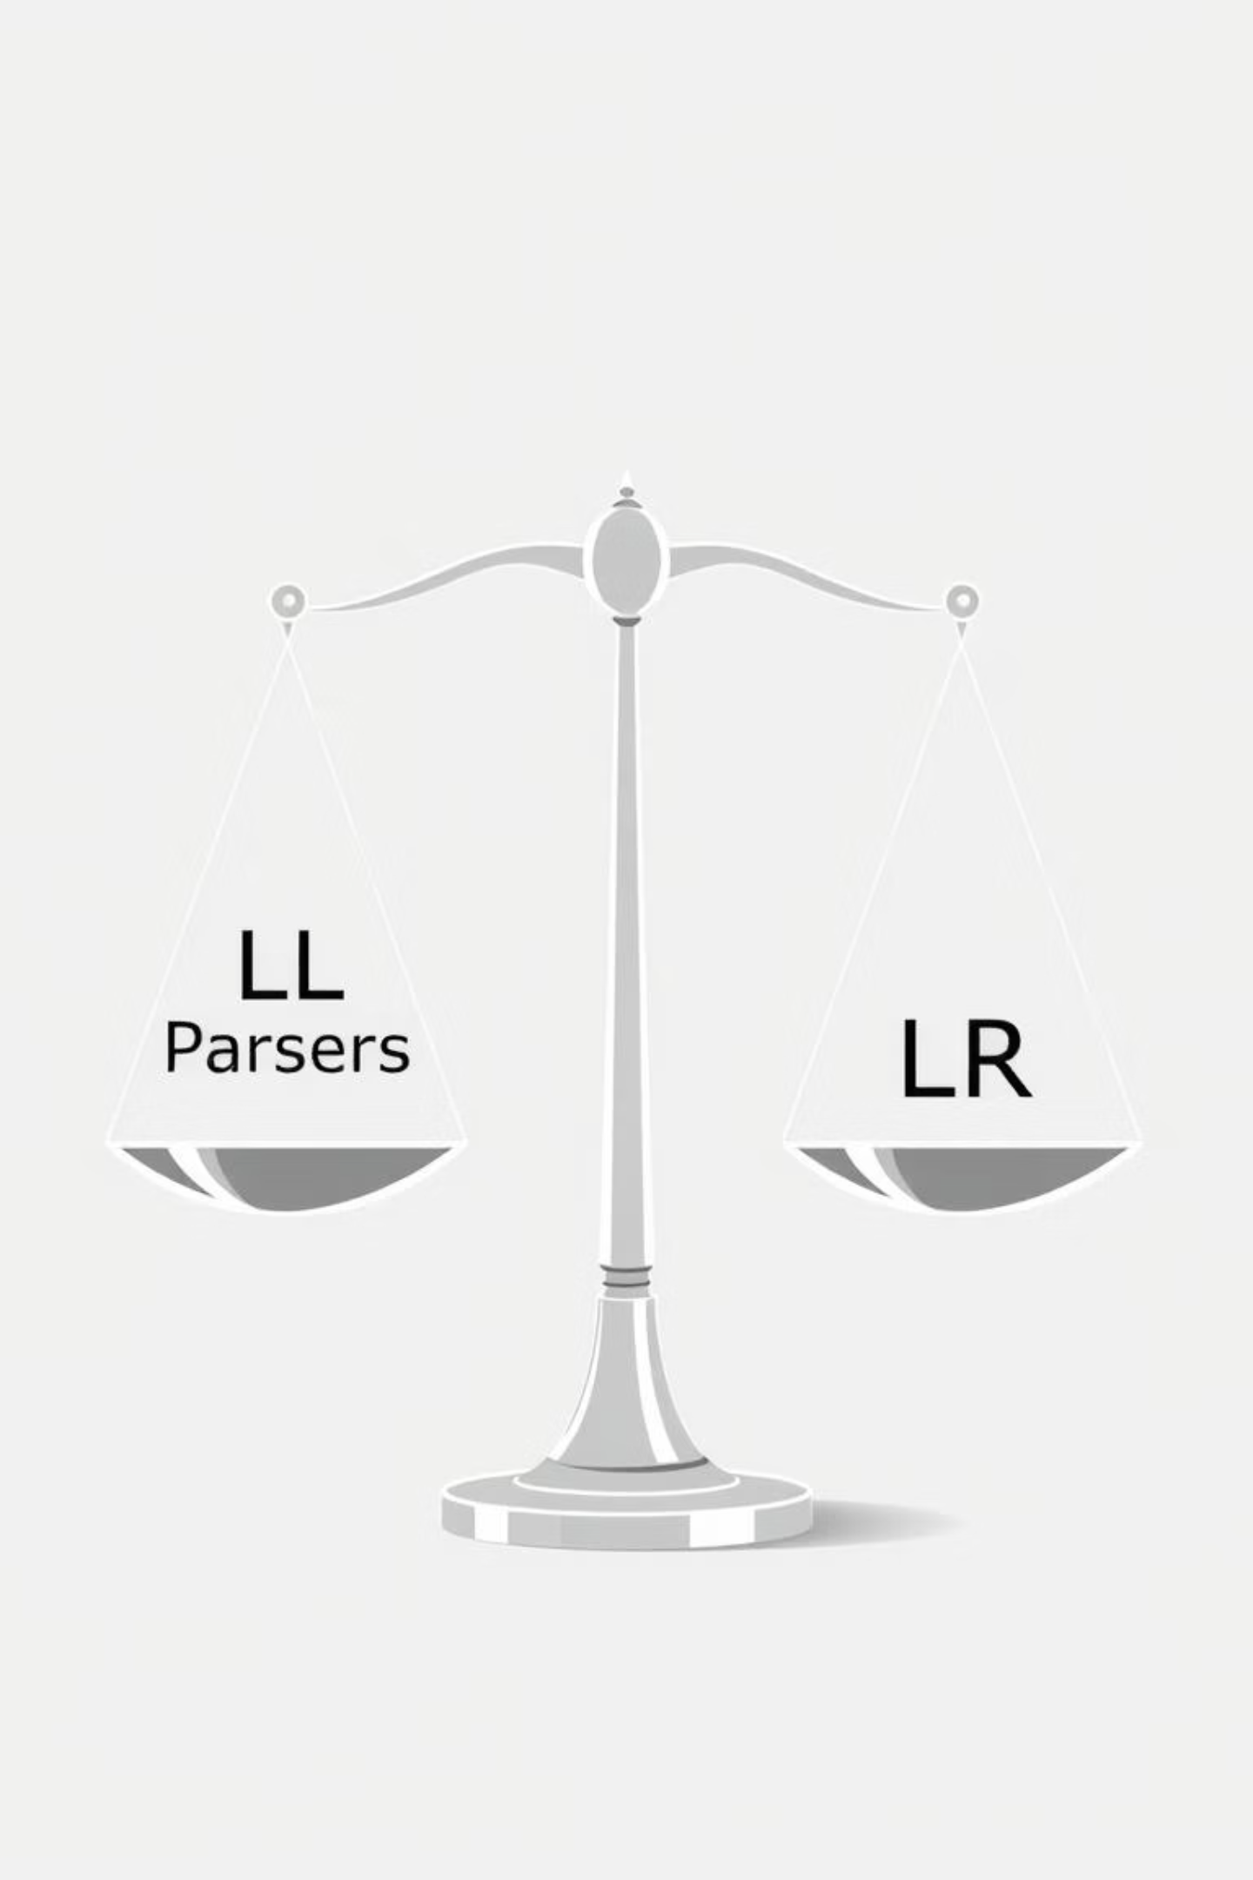


When NOT to Eliminate Left Recursion
LR Parsers
Shift-reduce parsers (SLR, LALR, LR) handle left recursion naturally. Left-recursive grammars can produce more efficient LR parsers.
Operator Associativity
Left recursion naturally expresses left-associative operators (e.g., 3 + 4 + 5 as ((3 + 4) + 5)). Elimination creates right-associative structures that need correction.
Trade-off
LL parsers MUST eliminate it; LR parsers can keep it, often preferred.

Slide 10




Tools That Handle Left Recursion
ANTLR
Performs left recursion elimination automatically.
// ANTLR automatically handles this
expr : expr '+' term
| expr '-' term
| term
;
JavaCC
Requires transformed grammars.
Bison/Yacc
Accept left-recursive grammars (LR-based).
Modern Approach
Parser generators increasingly handle left recursion automatically or provide alternatives, simplifying compiler design.

Slide 11
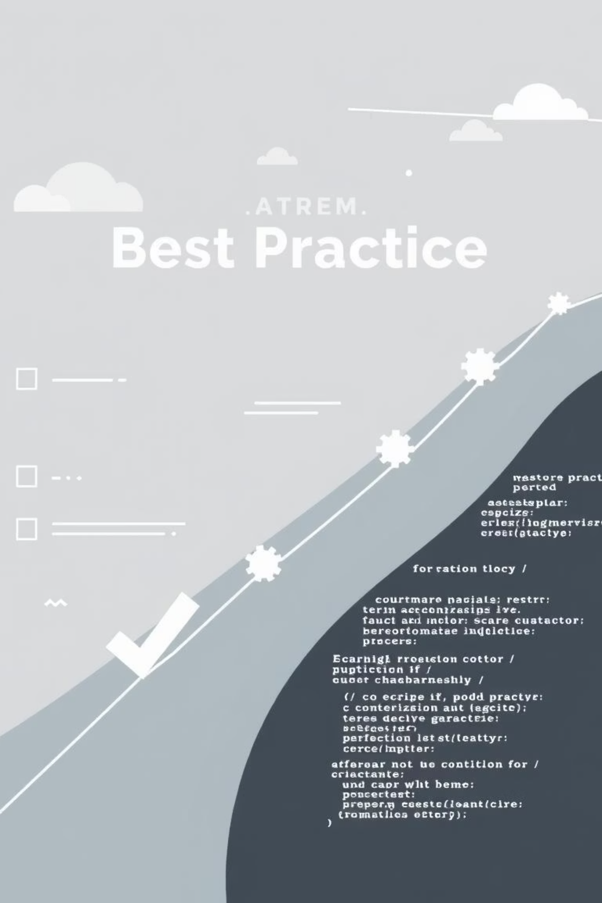
Best Practices and Common Pitfalls
Do's
Always check for left recursion when designing LL parsers
Use established algorithms for elimination
Verify semantic equivalence after transformation
Consider associativity requirements
Don'ts
Eliminate left recursion unnecessarily for LR parsers
Forget about indirect left recursion
Assume elimination preserves all semantic properties automatically
Common Pitfall
Understanding indirect left recursion in grammar transformation is crucial. A common mistake occurs when simplifying grammars, leading to incorrect parsing behavior:
Original Grammar (generates a*):
A → A a | ε
Incorrect Transformation (missing ε handling):
A → A' a | ε
Correct Transformation:
A → A'
A' → a A' | ε

Slide 12

Conclusion
Key Concepts
Left recursion occurs when a non-terminal can derive itself as the leftmost symbol.
Why It Matters
It is a critical problem for top-down parsers (LL, recursive descent), leading to infinite loops.
Solutions
Elimination algorithms transform grammars while preserving the language.
Direct elimination is straightforward; indirect requires a systematic approach.
While modern tools often handle this automatically, understanding these concepts remains essential for compiler designers.

Slide 13

References & Further Reading
Core Textbooks
Tools & Implementations
Aho, A. V., Lam, M. S., Sethi, R., & Ullman, J. D. (2006). Compilers: Principles, Techniques, and Tools (2nd ed.). Pearson. (Pages 214-217)
Parr, T. (2013). The Definitive ANTLR 4 Reference. Pragmatic Bookshelf.
Cooper, K. D., & Torczon, L. (2011). Engineering a Compiler (2nd ed.). Morgan Kaufmann.
Grune, D., & Jacobs, C. J. (2008). Parsing Techniques: A Practical Guide. Springer.
Online Resources
"Left Recursion" – Wikipedia: https://en.wikipedia.org/wiki/Left_recursion

